Slide 2
Topic Name:Domain and Range
Student Name : Mohammed akbar hossen
Id : 223031005 Batch : 29th

Slide 3
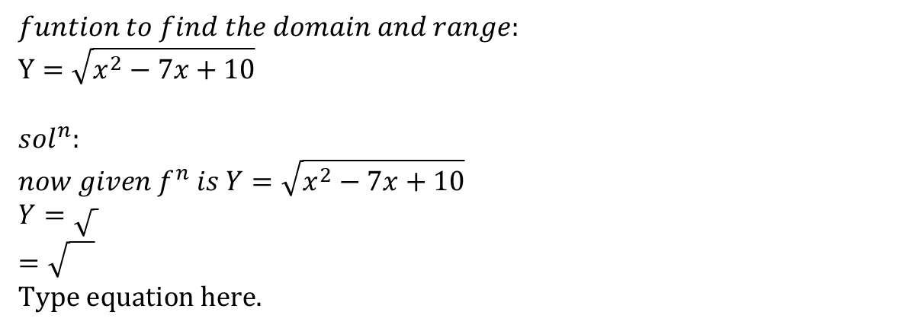
$$funtion to find the domain and range: \\ Y=\sqrt{x^{2}−7x+10}$$ $$sol^{n}: \\ now given f^{n} is Y=\sqrt{x^{2}−7x+10} \\ Y=\sqrt{ } \\ =\sqrt{}$$

